Slide 1

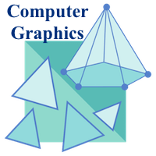
Introduction
It is difficult to display an image of any size on the computer screen. This method is simplified by using Computer graphics. Graphics on the computer are produced by using various algorithms and techniques.
Computer Graphics involves technology to access. The Process transforms and presents information in a visual form. The role of computer graphics insensible. In today life, computer graphics has now become a common element in user interfaces, T.V. commercial motion pictures.
Computer Graphics is the creation of pictures with the help of a computer. The end product of the computer graphics is a picture it may be a business graph, drawing, and engineering.
In computer graphics, two or three-dimensional pictures can be created that are used for research. Many hardware devices algorithm has been developing for improving the speed of picture generation with the passes of time. It includes the creation storage of models and image of objects. These models for various fields like engineering, mathematical and so on.
Today computer graphics is entirely different from the earlier one. It is not possible. It is an interactive user can control the structure of an object of various input devices.

Slide 2
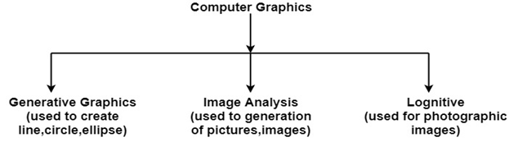
Introduction
Definition of Computer Graphics:
It is the use of computers to create and manipulate pictures on a display device. It comprises of software techniques to create, store, modify, represents pictures.
Why computer graphics used?
Suppose a shoe manufacturing company want to show the sale of shoes for five years. For this vast amount of information is to store. So a lot of time and memory will be needed. This method will be tough to understand by a common man. In this situation graphics is a better alternative. Graphics tools are charts and graphs. Using graphs, data can be represented in pictorial form. A picture can be understood easily just with a single look.
Interactive computer graphics work using the concept of two-way communication between computer users. The computer will receive signals from the input device, and the picture is modified accordingly. Picture will be changed quickly when we apply command.

Slide 3
Introduction
The Advantages of Interactive Graphics:
In interactive Computer Graphics user have some controls over the picture, i.e., the user can make any change in the produced image. One example of it is the ping-pong game.
Interactive Computer Graphics require two-way communication between the computer and the user. A User can see the image and make any change by sending his command with an input device.
Advantages:
Higher Quality
More precise results or products
Greater Productivity
Lower analysis and design cost
Significantly enhances our ability to understand data and to perceive trends.

Slide 4
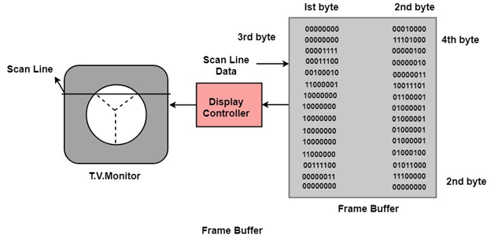
Introduction
Working of Interactive Computer Graphics:
The modern graphics display is very simple in construction. It consists of three components:
Frame Buffer or Digital Memory
A Monitor likes a home T.V. set without the tuning and receiving electronics.
Display Controller or Video Controller: It passes the contents of the frame buffer to the monitor.
Frame Buffer: A digital frame buffer is large, contiguous piece of computer memory used to hold or map the image displayed on the screen.

Slide 5
Introduction
Representative Uses of Computer Graphics:
The use of computer graphics is wide spread. It is used in various areas such as industry, business, government organizations, education, entertainment and most recently the home. Let us discuss representative uses of computer graphics in brief.
User friendliness is one of the main factors underlying the success and popularity of any system. It is now a well established fact that graphical interfaces provide in attractive and easy interaction between users and computers. The built-in graphics provided with user interfaces use visual control items such as buttons, menus, icons, scroll bar etc, which allows user to interact with computer only by mouse-click. Typing is necessary only to input text to be stored and manipulated.
In industry, business, government and educational organizations, computer graphics is most commonly used to create 2D and 3D graphics of mathematical, physical and economic functions in form of histograms, bars, and pie-chats. These graphs and charts are very useful for decision making.
The desktop publishing on personal computers allow the use of graphics for the creation and dissemination of information. Many organizations does the in-house creation and dissemination of documents. The desktop publishing allows user to create documents which contain text, tables, graphs, and other forms of drawn or scanned images or pictures. This is one approach towards the office automation.

Slide 6
Introduction
The computer-aided drafting uses graphics to design components and systems electrical, mechanical, electromechanical and electronic devices such as automobile bodies, structures of building, airplane, slips, very large-scale integrated chips, optical systems and computer networks.
Use of graphics in simulation makes mathematic models and mechanical systems more realistic and easy to study. The interactive graphics supported by animation software proved their use in production of animated movies and cartoons films.
There is lot of development in the tools provided by computer graphics. This allows user to create artistic pictures which express messages and attract attentions. Such pictures are very useful in advertising.
By the use of computer now it is possible to control various processes in the industry from a remote control room. In such cases, process systems and processing parameters are shown on the computer with graphic symbols and identification. This makes it easy for operator to monitor and control various processing parameters at a time.
Computer graphics is also used to represent geographic maps, weather maps, oceanographic charts, contour maps, population density maps and so on.

Slide 7
Introduction
Applications of Computer Graphics:
Computer graphics deals with creation, manipulation and storage of different type of images and objects.
Some of the applications of computer graphics are:
Computer Art:
Using computer graphics we can create fine and commercial art which include animation packages, paint packages. These packages provide facilities for designing object shapes and specifying object motion. Cartoon drawing, paintings, logo design can also be done.
Computer Aided Drawing:
Designing of buildings, automobile, aircraft is done with the help of computer aided drawing, this helps in providing minute details to the drawing and producing more accurate and sharp drawings with better specifications.
Presentation Graphics:
For the preparation of reports or summarizing the financial, statistical, mathematical, scientific, economic data for research reports, managerial reports, moreover creation of bar graphs, pie charts, time chart, can be done using the tools present in computer graphics.

Slide 8
Introduction
Applications of Computer Graphics:
Entertainment:
Computer graphics finds a major part of its utility in the movie industry and game industry. Used for creating motion pictures , music video, television shows, cartoon animation films. In the game industry where focus and interactivity are the key players, computer graphics helps in providing such features in the efficient way.
Education:
Computer generated models are extremely useful for teaching huge number of concepts and fundamentals in an easy to understand and learn manner. Using computer graphics many educational models can be created through which more interest can be generated among the students regarding the subject.
Training:
Specialized system for training like simulators can be used for training the candidates in a way that can be grasped in a short span of time with better understanding. Creation of training modules using computer graphics is simple and very useful.

Slide 9
Introduction
Applications of Computer Graphics:
Visualization:
Today the need of visualize things have increased drastically, the need of visualization can be seen in many advance technologies , data visualization helps in finding insights of the data , to check and study the behaviour of processes around us we need appropriate visualization which can be achieved through proper usage of computer graphics.
Image Processing:
Various kinds of photographs or images require editing in order to be used in different places. Processing of existing images into refined ones for better interpretation is one of the many applications of computer graphics.
Machine Drawing:
Computer graphics is very frequently used for designing, modifying and creation of various parts of machine and the whole machine itself, the main reason behind using computer graphics for this purpose is the precision and clarity we get from such drawing is ultimate and extremely desired for the safe manufacturing of machine using these drawings.

Slide 10
Introduction
Applications of Computer Graphics:
Graphical User Interface:
The use of pictures, images, icons, pop-up menus, graphical objects helps in creating a user friendly environment where working is easy and pleasant, using computer graphics we can create such an atmosphere where everything can be automated and anyone can get the desired action performed in an easy fashion.

Slide 11
Introduction
Development of hardware and software for Computer Graphics:
Hardware:
Mouse- Used to navigate around digital graphics software. A mouse is also used to navigate around a computer, and to launch programs/applications.
Monitor/Screen- Displays a picture/image that you may be editing using digital graphics software.
RAM (Random Access Memory – Makes your computer faster. The more RAM you have the quicker your PC will be. Therefore when using digital graphics software, the software is more likely to run smoother and quicker.
CPU (Central Processing Unit)- Executes commands that are given to it. For example in digital graphics, if you type in some code, your CPU then process’s that and then executes the command.
Hard Disk Drive (HDD) & Solid State Drive (SSD)- Both SSD’s and HDD’s store data or memory. However HDD’s are slower than SSD’s. It’s also worth noting SSD’s can not defragged, as they defrag automatically. If you try to format a SSD, it will probably not work. Either a SSD or HDD can be used in digital graphics, as they both store data/memory (or your work).
Digital Camera- Used to take pictures or videos. These videos/pictures can then be used in digital graphics once they have been uploaded to your computers HDD/SDD.

Slide 12
Introduction
Printer- Used to print out pictures or documents. This can be used in digital graphics, to print out your work.
Scanner- Used to scan photos or documents into a computer. You can then use these pictures in digital graphics software.
USB (Universal Serial Bus)- Used to transfer data/memory around portably. This can be used in digital graphics to transfer your finished pictures or videos around.
Software:
Adobe Photoshop (Raster Graphics)- Used to enhance and manipulate photos and to create original digital art.
Adobe Illustrator (Vector Graphics)- A program that is used by both artists and graphic designers to create vector images. These images will then be used for company logos, promotional material both in print and digital form.

Slide 13
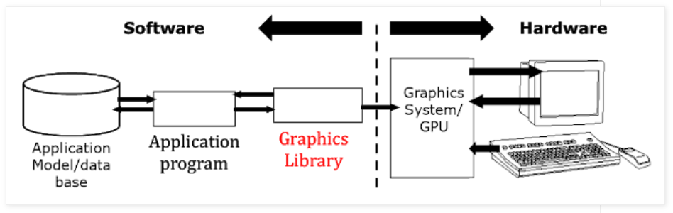
Introduction
Conceptual Framework for Interactive Graphics
Graphics library/package is intermediary between application and display hardware (Graphics System)
Application program maps application objects to views (images) of those objects by calling on graphics library. Application model may contain lots of non-graphical data (e.g., non-geometric object properties)
User interaction results in modification of model and/or image
This hardware and software framework is more than 4 decades old but is still useful.

